Slide 1

DATA MINING 1 Pattern Mining & Association Rule Mining
Fosca Giannotti, Roberto Pellungrini
Revisited slides from Lecture Notes for Chapter 5 “Introduction to Data Mining”, 2nd Edition by Tan, Steinbach, Karpatne, Kumar
also used into the Data Mining course of Data Science Master Degree at Department of Computer Science, Univ. Pisa

Slide 2
Association Rules - Module Outline
What are association rules (AR) and what are they used for:
The paradigmatic application: Market Basket Analysis
The single dimensional AR (intra-attribute)

Slide 3
Market Basket Analysis: The Context
Analyzing customer purchasing habits by finding associations and correlations between the different items that customers place in their “shopping basket”
Milk, eggs, sugar, bread
Milk, eggs, cereal, bread
Eggs, sugar
Customer1
Customer2
Customer3

Slide 4
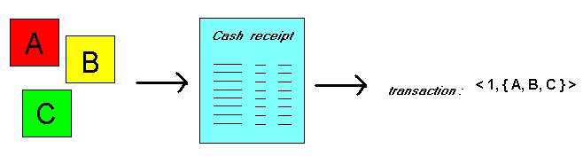
Market Basket Analysis: The Context
Given: a database of customer transactions, where each transaction is a set of items.
Goal: Find groups of items which are frequently purchased together.

Slide 5
Goal of MBA
Extract information on purchasing behavior
Actionable information: can suggest
new store layouts
new product assortments
which products to put on promotion
MBA applicable whenever a customer purchases multiple things in proximity
credit cards
services of telecommunication companies
banking services
medical treatments

Slide 6
MBA: applicable to many other contexts
Telecommunication:
Each customer is a transaction containing the set of customer’s phone calls
Atmospheric phenomena:
Each time interval (e.g. a day) is a transaction containing the set of observed event (rains, wind, etc.)
Etc.

Slide 7
Association Rules
Express how product/services relate to each other, and tend to group together
“if a customer purchases three-way calling, then will also purchase call-waiting”
simple to understand
actionable information: bundle three-way calling and call-waiting in a single package
Examples.
Rule form: “Body → Ηead [support, confidence]”.
buys(x, “diapers”) → buys(x, “beers”) [0.5%, 60%]
major(x, “CS”) and takes(x, “DB”) → grade(x, “A”) [1%, 75%]
X → Y
Body/Head/Antecedent
Head/Tail/Consequent

Slide 8
Useful, trivial, unexplicable
Useful: “On Thursdays, grocery store consumers often purchase diapers and beer together”.
Trivial: “Customers who purchase maintenance agreements are very likely to purchase large appliances”.
Unexplicable: “When a new hardaware store opens, one of the most sold items is toilet rings.”

Slide 9
Association Rule Mining
Given a set of transactions, find rules that will predict the occurrence of an item based on the occurrences of other items in the transaction
Market-Basket transactions
Example of Association Rules
{Diaper} → {Beer}, {Milk, Bread} → {Eggs,Coke}, {Beer, Bread} → {Milk},
Implication means co-occurrence, not causality!
Find groups of items which are frequently purchased together

Slide 10
Definition: Frequent Itemset
Itemset
A collection of one or more items
Example: {Milk, Bread, Diaper}
k-itemset
An itemset that contains k items
Support count (σ)
Frequency of occurrence of an itemset
E.g. σ({Milk, Bread,Diaper}) = 2
Support
Fraction of transactions that contain an itemset
E.g. s({Milk, Bread, Diaper}) = 2/5
Frequent Itemset
An itemset whose support is greater than or equal to a minsup threshold

Slide 11
Definition: Association Rule
Association Rule
An implication expression of the form X → Y, where X and Y are itemsets
Example: {Milk, Diaper} → {Beer}
Rule Evaluation Metrics
Support (s)
Fraction of transactions that contain both X and Y
Confidence (c)
Measures how often items in Y appear in transactions that contain X
Example:

Slide 12
Association Rules: measures Meaning
X ⇒ Y [ s, c ]
Support: denotes the frequency of the rule within transactions. A high value means that the rule involve a great part of database. (HOW POPULAR IS THE GROUP)
support(X ⇒ Y) = Pr(X & Y)
Confidence: denotes the percentage of transactions containing X which contain also Y. It is an estimation of conditioned probability . (how likely is B given A)
Confidence(X ⇒ Y) = Pr(Y|X) = Pr(X & Y)/Pr(X).

Slide 13
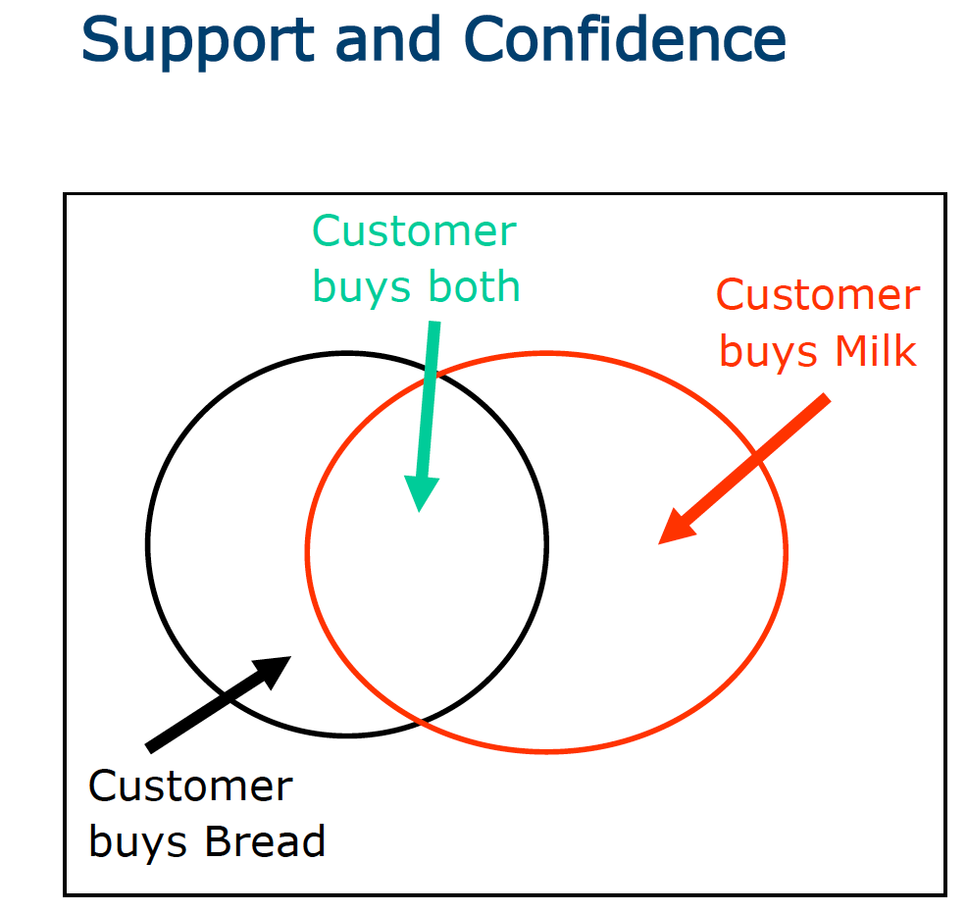

Slide 14
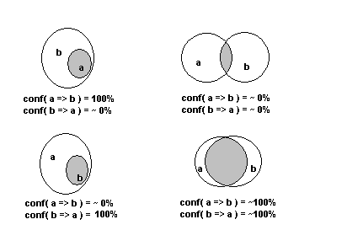
Association Rules – the effect

Slide 15
Valid Rules and minsup and min conf
Given a set of transactions T, the valid rules are those association rule mining is to find all rules having
support ≥ minsup threshold, σ
confidence ≥ minconf threshold γ

Slide 16
Association Rules – the parameters σ and γ
Minimum Support σ :
High ⇒ few frequent itemsets
⇒ few valid rules which occur very often
Low ⇒ many valid rules which occur rarely
Minimum Confidence γ :
High ⇒ few rules, but all “almost logically true”
Low ⇒ many rules, but many of them very “uncertain”
Typical Values: σ = 2 ÷10 % γ = 70 ÷90 %

Slide 17
Other measures: INTEREST
Problem: Confidence(X ⇒ Y) = Pr(Y|X) = Pr(X & Y)/Pr(X).
does not take into account the popularity of the consequent.
INTEREST= Pr(X & Y)/P(X)*P(Y) = Confidence /Pr(Y)
How likely is Y given X, while controlling the popularity of Y
Interest expresses measure of correlation
= 1 ⇒ X and Y are independent events (the rule does not make sense)
less than 1 ⇒ X and Y negatively correlated,
greater than 1 ⇒ X and Y positively correlated
Other measures
Val = Pr(Y | X) – Pr(Y) = Confidence – Pr(Y)
LIFT = Pr(Y | X) / Pr(Y) = Confidence / Pr(Y)= INTEREST

Slide 18
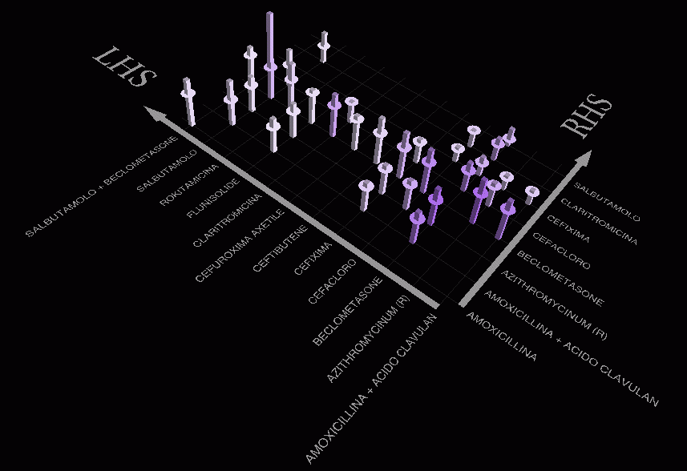
Association Rules – visualization
(Patients <15 old for USL 19 (a unit of Sanitary service), January-September 1997)
SULBUTAMOLO
=> BECLOMETASONE
Supp=~4% Conf=57%
AZITHROMYCINUM (R)
=> BECLOMETASONE
Supp=5,7% Conf=34,5%

Slide 19
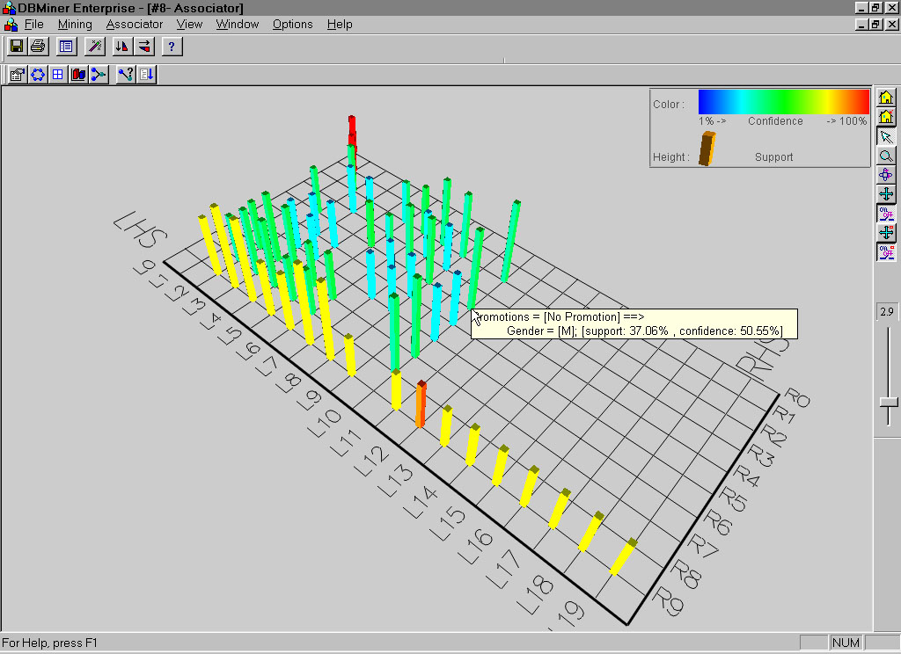
Visualization of Association Rules: Plane Graph

Slide 20
Association Rule Mining Task
Given a set of transactions T, the goal of association rule mining is to find all rules having
support ≥ minsup threshold
confidence ≥ minconf threshold
Brute-force approach:
List all possible association rules
Compute the support and confidence for each rule
Prune rules that fail the minsup and minconf thresholds
⇒ Computationally prohibitive!

Slide 21
Mining Association Rules
Example of Rules:
{Milk,Diaper} → {Beer} (s=0.4, c=0.67) {Milk,Beer} → {Diaper} (s=0.4, c=1.0)
{Diaper,Beer} → {Milk} (s=0.4, c=0.67)
{Beer} → {Milk,Diaper} (s=0.4, c=0.67) {Diaper} → {Milk,Beer} (s=0.4, c=0.5)
{Milk} → {Diaper,Beer} (s=0.4, c=0.5)
Observations:
All the above rules are binary partitions of the same itemset: {Milk, Diaper, Beer}
Rules originating from the same itemset have identical support but can have different confidence
Thus, we may decouple the support and confidence requirements

Slide 22
Mining Association Rules
Two-step approach:
Frequent Itemset Generation
Generate all itemsets whose support ≥ minsup
Rule Generation
Generate high confidence rules from each frequent itemset, where each rule is a binary partitioning of a frequent itemset
Frequent itemset generation is still computationally expensive

Slide 23
Exercise1
Support?: e, (b,d), (b,d,e)

Slide 24
Exercise2
Max size of itemset, 2-itemsets with larger support

Slide 25
Exercise3
ID Transazione Items
1 {f,a,d,b}
2 {d,a,c,e,b}
3 {c,a,b,e}
4 {b,a,d}
Fissati il supporto minimo σ = 60%
a) Indicare quali tra questi itemset sono frequenti.
1) {a}
2) {c}
3) {b,c}
4) {b,d}
5) {a,b,d}
6) {a,b,e}

Slide 26
Exercise4
ID Transazione Items
1 {f,a,d,b}
2 {d,a,c,e,b}
3 {c,a,b,e}
4 {b,a,d}
Fissati il supporto minimo σ = 60% e la confidenza minima γ = 80%
b) Indicare quali tra queste regole sono valide
1) {a}=>{b}
2) {a}=>{d}
3) {d}=>{a}
4) {d}=>{a,b}
5) {a,b}=>{d}

Slide 27
Basic Apriori Algorithm
Problem Decomposition
Find the frequent itemsets: the sets of items that satisfy the support constraint
A subset of a frequent itemset is also a frequent itemset, i.e., if {A,B} is a frequent itemset, both {A} and {B} should be a frequent itemset
Iteratively find frequent itemsets with cardinality from 1 to k (k-itemset)
Use the frequent itemsets to generate association rules.

Slide 28
Frequent Itemset Generation
Given d items, there are 2^{d} possible candidate itemsets

Slide 29
Frequent Itemset Generation
Brute-force approach:
Each itemset in the lattice is a candidate frequent itemset
Count the support of each candidate by scanning the database
Match each transaction against every candidate
Complexity ~ O(NMw) => Expensive since M = 2^{d} !!!

Slide 30
Frequent Itemset Generation Strategies
Reduce the number of candidates (M)
Complete search: M=2^{d}
Use pruning techniques to reduce M
Reduce the number of transactions (N)
Reduce size of N as the size of itemset increases
Reduce the number of comparisons (NM)
Use efficient data structures to store the candidates or transactions
No need to match every candidate against every transaction

Slide 31
Reducing Number of Candidates
Apriori principle:
If an itemset is frequent, then all of its subsets must also be frequent
Apriori principle holds due to the following property of the support measure:
Support of an itemset never exceeds the support of its subsets
This is known as the anti-monotone property of support

Slide 32
Illustrating Apriori Principle
Found to be Infrequent
Pruned supersets

Slide 33
Illustrating Apriori Principle
Items (1-itemsets)
Minimum Support = 3

Slide 34
Illustrating Apriori Principle
Items (1-itemsets)
Minimum Support = 3

Slide 35
Illustrating Apriori Principle
Items (1-itemsets)
Pairs (2-itemsets)
(No need to generate candidates involving Coke or Eggs)
Minimum Support = 3

Slide 36
Illustrating Apriori Principle
Items (1-itemsets)
Pairs (2-itemsets)
(No need to generate candidates involving Coke or Eggs)
Minimum Support = 3

Slide 37
Illustrating Apriori Principle
Items (1-itemsets)
Pairs (2-itemsets)
(No need to generate candidates involving Coke or Eggs)
Minimum Support = 3
Triplets (3-itemsets)
(No need to generate candidates involving Bread, Beer or Milk, Beer)

Slide 38
Illustrating Apriori Principle
Items (1-itemsets)
Pairs (2-itemsets)
(No need to generate candidates involving Coke or Eggs)
Minimum Support = 3
Triplets (3-itemsets)

Slide 39
Illustrating Apriori Principle
Items (1-itemsets)
Pairs (2-itemsets)
(No need to generate candidates involving Coke or Eggs)
Minimum Support = 3
Triplets (3-itemsets)

Slide 40
Basic Apriori Algorithm
Find the frequent itemsets: the sets of items that satisfy the support constraint
A subset of a frequent itemset is also a frequent itemset, i.e., if {A,B} is a frequent itemset, both {A} and {B} should be a frequent itemset
Iteratively find frequent itemsets with cardinality from 1 to k (k-itemset)
Use the frequent itemsets to generate association rules.

Slide 41
Apriori Algorithm
F_{k}: frequent k-itemsets
L_{k}: candidate k-itemsets
Algorithm
Let k=1
Generate F₁ = {frequent 1-itemsets}
Repeat until F_{k} is empty
Candidate Generation: Generate L_{k+1} from F_{k}
Candidate Pruning: Prune candidate itemsets in L_{k+1} containing subsets of length k that are infrequent
Support Counting: Count the support of each candidate in L_{k+1} by scanning the DB
Candidate Elimination: Eliminate candidates in L_{k+1} that are infrequent, leaving only those that are frequent => F_{k+1}

Slide 42
Candidate Generation: F_{k-1} x F_{k-1} Method
Merge two frequent (k-1)-itemsets if their first (k-2) items are identical
F₃ = {ABC,ABD,ABE,ACD,BCD,BDE,CDE}
Merge(ABC, ABD) = ABCD
Merge(ABC, ABE) = ABCE
Merge(ABD, ABE) = ABDE
Do not merge(ABD,ACD) because they share only prefix of length 1 instead of length 2

Slide 43
Candidate Pruning
Let F₃ = {ABC,ABD,ABE,ACD,BCD,BDE,CDE} be the set of frequent 3-itemsets
L₄ = {ABCD,ABCE,ABDE} is the set of candidate 4-itemsets generated (from previous slide)
Candidate pruning
Prune ABCE because ACE and BCE are infrequent
Prune ABDE because ADE is infrequent
After candidate pruning: L₄ = {ABCD}

Slide 44
Illustrating Apriori Principle
Items (1-itemsets)
Pairs (2-itemsets)
(No need to generate candidates involving Coke or Eggs)
Minimum Support = 3
Triplets (3-itemsets)
Use of F_{k-1}xF_{k-1} method for candidate generation results in
only one 3-itemset. This is eliminated after the support counting step.

Slide 45
Support Counting of Candidate Itemsets
Scan the database of transactions to determine the support of each candidate itemset
Must match every candidate itemset against every transaction, which is an expensive operation

Slide 46
Apriori Execution Example (min_sup = 2)
Database TDB
C₁
L₁
Scan TDB
L₂
C₂
C₂
Scan TDB
C₃
Scan TDB
L₃

Slide 47
Rule Generation
Given a frequent itemset L, find all non-empty subsets f ⊂ L such that f → L – f satisfies the minimum confidence requirement
If {A,B,C,D} is a frequent itemset, candidate rules:
ABC →D, ABD →C, ACD →B, BCD →A, A →BCD, B →ACD, C →ABD, D →ABC AB →CD, AC → BD, AD → BC, BC →AD, BD →AC, CD →AB,
If |L| = k, then there are 2^{k} – 2 candidate association rules (ignoring L → ∅ and ∅ → L)

Slide 48
Rule Generation
In general, confidence does not have an anti-monotone property
c(ABC →D) can be larger or smaller than c(AB →D)
But confidence of rules generated from the same itemset has an anti-monotone property
E.g., Suppose {A,B,C,D} is a frequent 4-itemset: c(ABC → D) ≥ c(AB → CD) ≥ c(A → BCD)
Confidence is anti-monotone w.r.t. number of items on the RHS of the rule

Slide 49
Rule Generation for Apriori Algorithm
Lattice of rules
Low Confidence Rule
Pruned Rules

Slide 50
Maximal Frequent Itemset
An itemset is maximal frequent if it is frequent and none of its immediate supersets is frequent
Maximal Itemsets
Infrequent Itemsets
Border

Slide 51
Closed Itemset
An itemset X is closed if none of its immediate supersets has the same support as the itemset X.
X is not closed if at least one of its immediate supersets has support count as X.

Slide 52
Maximal vs Closed Itemsets

Slide 53
Pattern Evaluation
Association rule algorithms can produce large number of rules
Interestingness measures can be used to prune/rank the patterns
In the original formulation, support & confidence are the only measures used

Slide 54
Computing Interestingness Measure
Given X → Y or {X,Y}, information needed to compute interestingness can be obtained from a contingency table
Contingency table
 | Y | Y
X | f₁₁ | f₁₀ | f₁₊
X | f₀₁ | f₀₀ | f_{o+}
 | f₊₁ | f₊₀ | N
f₁₁: support of X and Y f₁₀: support of X and Y f₀₁: support of X and Y f₀₀: support of X and Y
Used to define various measures
support, confidence, Gini, entropy, etc.

Slide 55
Drawback of Confidence
Customers | Tea | Coffee | …
C1 | 0 | 1 | …
C2 | 1 | 0 | …
C3 | 1 | 1 | …
C4 | 1 | 0 | …
…
Association Rule: Tea → Coffee
Confidence ≅ P(Coffee|Tea) = 150/200 = 0.75
Confidence > 50%, meaning people who drink tea are more likely to drink coffee than not drink coffee
So rule seems reasonable

Slide 56
Drawback of Confidence
 | Coffee | Coffee
Tea | 150 | 50 | 200
Tea | 650 | 150 | 800
 | 800 | 200 | 1000
Association Rule: Tea → Coffee
Confidence= P(Coffee|Tea) = 150/200 = 0.75
but P(Coffee) = 0.8, which means knowing that a person drinks tea reduces the probability that the person drinks coffee!
Note that P(Coffee|Tea) = 650/800 = 0.8125

Slide 57
Measure for Association Rules
So, what kind of rules do we really want?
Confidence(X → Y) should be sufficiently high
To ensure that people who buy X will more likely buy Y than not buy Y
Confidence(X → Y) > support(Y)
Otherwise, rule will be misleading because having item X actually reduces the chance of having item Y in the same transaction
Is there any measure that capture this constraint?
Answer: Yes. There are many of them.

Slide 58
Statistical Relationship between X and Y
The criterion confidence(X → Y) = support(Y)
is equivalent to:
P(Y|X) = P(Y)
P(X,Y) = P(X) × P(Y) (X and Y are independent)
If P(X,Y) > P(X) × P(Y) : X & Y are positively correlated
If P(X,Y) < P(X) × P(Y) : X & Y are negatively correlated

Slide 59
Measures that take into account statistical dependence
lift is used for rules while interest is used for itemsets

Slide 60
Example: Lift/Interest
 | Coffee | Coffee
Tea | 150 | 50 | 200
Tea | 650 | 150 | 800
 | 800 | 200 | 1000
Association Rule: Tea → Coffee
Confidence= P(Coffee|Tea) = 0.75
but P(Coffee) = 0.8
Interest = 0.15 / (0.2×0.8) = 0.9375 (< 1, therefore is negatively associated)

Slide 61
Multidimensional AR
Associations between values of different attributes :
RULES:
nationality = French ⇒ income = high [50%, 100%]
income = high ⇒ nationality = French [50%, 75%]
age = 50 ⇒ nationality = Italian [33%, 100%]

Slide 62
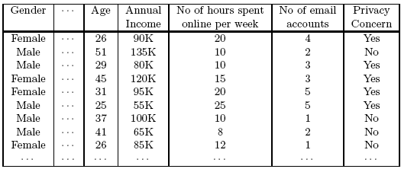
Continuous and Categorical Attributes
How to apply association analysis to non-asymmetric binary variables?
Example of Association Rule:
{Gender=Male, Age ∈ [21,30)} → {No of hours online ≥ 10}

Slide 63
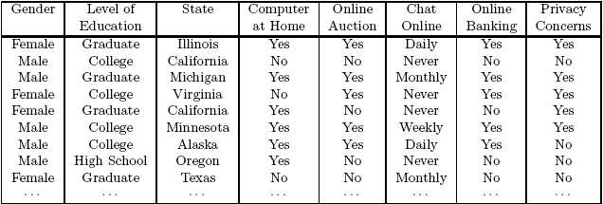
Handling Categorical Attributes
Example: Internet Usage Data
{Level of Education=Graduate, Online Banking=Yes} → {Privacy Concerns = Yes}

Slide 64
Single-dimensional vs Multi-dimensional AR
Multi-dimensional Single-dimensional
<1, Italian, 50, low> <1, {nat/Ita, age/50, inc/low}>
<2, French, 45, high> <2, {nat/Fre, age/45, inc/high}>
Schema: <ID, a?, b?, c?, d?>
<1, yes, yes, no, no> <1, {a, b}>
<2, yes, no, yes, no> <2, {a, c}>

Slide 65
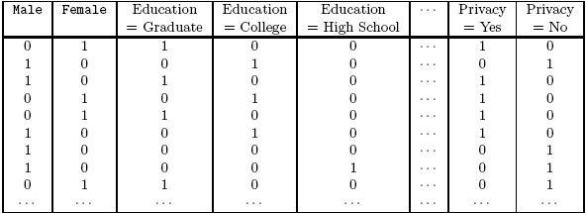
Handling Categorical Attributes
Introduce a new “item” for each distinct attribute-value pair

Slide 66
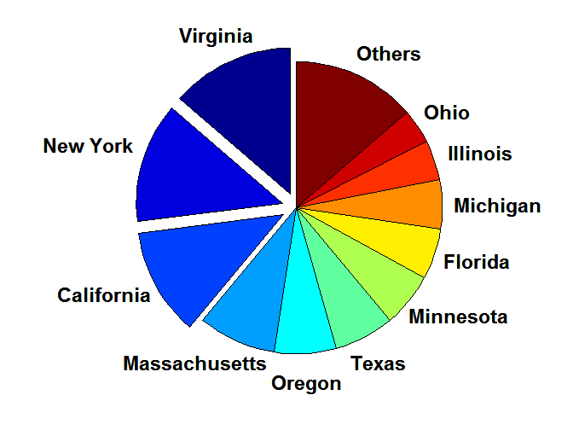
Handling Categorical Attributes
Some attributes can have many possible values
Many of their attribute values have very low support
Potential solution: Aggregate the low-support attribute values

Slide 67
Handling Continuous Attributes
Different methods:
Discretization-based
Statistics-based
Non-discretization based
minApriori
Different kinds of rules can be produced:
{Age∈[21,30), No of hours online∈[10,20)} → {Chat Online =Yes}
{Age∈[21,30), Chat Online = Yes} → No of hours online: μ=14, σ=4

Slide 68
Quantitative Attributes
Quantitative attributes (e.g. age, income)
Categorical attributes (e.g. color of car)
Problem: too many distinct values
Solution: transform quantitative attributes in categorical ones via discretization.

Slide 69
Quantitative Association Rules
[Age: 30..39] and [Married: Yes] ⇒ [NumCars:2]
support = 40%
confidence = 100%

Slide 70
Discretization of quantitative attributes
Solution: each value is replaced by the interval to which it belongs.
height: 0-150cm, 151-170cm, 171-180cm, >180cm
weight: 0-40kg, 41-60kg, 60-80kg, >80kg
income: 0-10ML, 11-20ML, 20-25ML, 25-30ML, >30ML
Problem: the discretization may be useless (see weight).

Slide 71

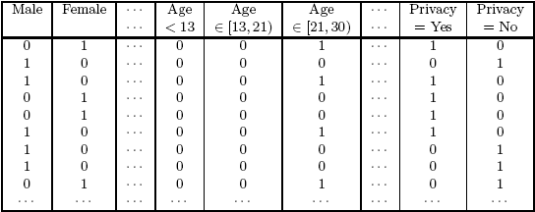
Discretization-based Methods

Slide 72
How to choose intervals?
Interval with a fixed “reasonable” granularity Ex. intervals of 10 cm for height.
Interval size is defined by some domain dependent criterion Ex.: 0-20ML, 21-22ML, 23-24ML, 25-26ML, >26ML
Interval size determined by analyzing data, studying the distribution or using clustering
50 - 58 kg
59-67 kg
> 68 kg

Slide 73
Multilevel AR
Is difficult to find interesting patterns at a too primitive level
high support = too few rules
low support = too many rules, most uninteresting
Approach: reason at suitable level of abstraction
A common form of background knowledge is that an attribute may be generalized or specialized according to a hierarchy of concepts
Dimensions and levels can be efficiently encoded in transactions
Multilevel Association Rules : rules which combine associations with hierarchy of concepts

Slide 74
Concept Hierarchies

Slide 75
Multi-level Association Rules
Why should we incorporate concept hierarchy?
Rules at lower levels may not have enough support to appear in any frequent itemsets
Rules at lower levels of the hierarchy are overly specific
e.g., skim milk → white bread, 2% milk → wheat bread, skim milk → wheat bread, etc. are indicative of association between milk and bread
Rules at higher level of hierarchy may be too generic

Slide 76
Multi-level Association Rules
Approach 1: Extend current association rule formulation by augmenting each transaction with higher level items
Original Transaction: {skim milk, wheat bread}
Augmented Transaction: {skim milk, wheat bread, milk, bread, food}
Issues:
Items that reside at higher levels have much higher support counts
if support threshold is low, too many frequent patterns involving items from the higher levels
Increased dimensionality of the data

Slide 77
Multi-level Association Rules
Approach 2:
Generate frequent patterns at highest level first
Then, generate frequent patterns at the next highest level, and so on
Issues:
I/O requirements will increase dramatically because we need to perform more passes over the data
May miss some potentially interesting cross-level association patterns

Slide 78
Reasoning with AR
Significance:
Example: <1, {a, b}>
<2, {a} >
<3, {a, b, c}>
<4, {b, d}>
{b} ⇒ {a} has confidence (66%)(2/3), but is not significant as support({a}) = 75%.

Slide 79
Beyond Support and Confidence
Example 1: (Aggarwal & Yu, PODS98)
Confidence= P(Coffee|Tea) = 0.80
P(Coffee) = 0.9
LIFT = 0.8/0.9= 0.8888 (< 1, therefore is negatively associated)

Slide 80
Domain dependent measures
Together with support, confidence, interest, …, use also (in post-processing) domain-dependent measures
E.g., use rule constraints on rules
Example: take only rules which are significant with respect their economic value
sum(LHS)+ sum(RHS) > 100

Slide 81
Rule Constraints
Rule form constraints: meta-rule guided mining.
P(x, y) ^ Q(x, w) → takes(x, “database systems”).
Rule content constraint: constraint-based query optimization
sum(LHS) < 100 ^ min(LHS) > 20 ^ sum(RHS) > 1000
1-var: A constraint confining only one side (L/R) of the rule, e.g., as shown above.
2-var: A constraint confining both sides (L and R).
sum(LHS) < min(RHS) ^ max(RHS) < 5* sum(LHS)

Slide 82
Which tools for market basket analysis?
Association rule are needed but insufficient
Market analysts ask for business rules:
Is supermarket assortment adequate for the company’s target class of customers?
Is a promotional campaign effective in establishing a desired purchasing habit?

Slide 83
Business rules: temporal reasoning on AR
Which rules are established by a promotion?
How do rules change along time?

Slide 84
Atherosclerosis prevention study
2nd Department of Medicine, 1st Faculty of Medicine of Charles University and Charles University Hospital, U nemocnice 2, Prague 2 (head. Prof. M. Aschermann, MD, SDr, FESC)

Slide 85
Atherosclerosis prevention study:
The STULONG 1 data set is a real database that keeps information about the study of the development of atherosclerosis risk factors in a population of middle aged men.
Used for Discovery Challenge at PKDD 00-02-03-04

Slide 86
The input data
Data from Entry and Exams
General characteristics | Examinations | habits
Marital status Transport to a job Physical activity in a job Activity after a job Education Responsibility Age Weight Height | Chest pain Breathlesness Cholesterol Urine Subscapular Triceps | Alcohol Liquors Beer 10 Beer 12 Wine Smoking Former smoker Duration of smoking Tea Sugar Coffee

Slide 87
The input data
DEATH CAUSE | PATIENTS | %
myocardial infarction | 80 | 20.6
coronary heart disease | 33 | 8.5
stroke | 30 | 7.7
other causes | 79 | 20.3
sudden death | 23 | 5.9
unknown | 8 | 2.0
tumorous disease | 114 | 29.3
general atherosclerosis | 22 | 5.7
TOTAL | 389 | 100.0

Slide 88
The prepared data

Slide 89
Descriptive Analysis/ Subgroup Discovery /Association Rules
Are there strong relations concerning death cause?
General characteristics (?) ⇒ Death cause (?)
Examinations (?) ⇒ Death cause (?)
Habits (?) ⇒ Death cause (?)
Combinations (?) ⇒ Death cause (?)

Slide 90
Example of extracted rules
Education(university) & Height<176-180> ⇒Death cause (tumouros disease), 16 ; 0.62
It means that on tumorous disease have died 16, i.e. 62% of patients with university education and with height 176-180 cm.

Slide 91
Example of extracted rules
Physical activity in work(he mainly sits) & Height<176-180> ⇒ Death cause (tumouros disease), 24; 0.52
It means that on tumorous disease have died 24 i.e. 52% of patients that mainly sit in the work and whose height is 176-180 cm.

Slide 92
Example of extracted rules
Education(university) & Height<176-180> ⇒Death cause (tumouros disease), 16; 0.62; +1.1;
the relative frequency of patients who died on tumorous disease among patients with university education and with height 176-180 cm is 110 per cent higher than the relative frequency of patients who died on tumorous disease among all the 389 observed patients

Slide 93
MBA in Text / Web Content Mining
Documents Associations
Find (content-based) associations among documents in a collection
Documents correspond to items and words correspond to transactions
Frequent itemsets are groups of docs in which many words occur in common
Term Associations
Find associations among words based on their occurrences in documents
similar to above, but invert the table (terms as items, and docs as transactions)

Slide 94
“COOL PATTERNS” BMA on retail COOP

Slide 95
Rule extraction with product Hierarchy
With reduced support.
Each level has its minimal support
Lower the level, lower the threshold
Regole interessanti → Lift maggiore di 1
Settore
Settore/Reparto
Categoria
Categoria/
Subcategoria
Articolo

Slide 96
Evaluation – RA – level Articoli
[ 10 BICCH.CART.BIBO CIRC.200CC ] → [ PIATTI CART.BIBO CIRCUS D23X10 ]
Support: 0,01 Confidence: 92,5 Lift: 4237,263
[ TELO 100X150 460 GR/MQ TU ] [ OSPITE 40X60 460 GR/MQ TU ] → [ ASCIUGAMANO 60X110 460 GR TU ]
Support: 0,01 Confidence: 91,4 Lift: 965,993
[ BOCC.CANI POLLO/TACCH.KG1.23 ] [ BOC/NI GATTO VITELLO SIM.KG415 ] → [ BOCC.GATTI CONIGLIO SIMBA G415 ]
Support: 0,01 Confidence: 91,4 Lift: 390,042
[ PIATTO FRUTTA MAZIME B.CO CM21 ] [ PIATTO F.DO MAXIME B.CO CM.17 ] → [ PIATTO P.NO MAXIME B.CO CM.25 ]
Support: 0,01 Confidence: 90 Lift: 3052,386
[ LENZUOLO PIANO 150X280 RIGHE ] [ LENZUOLO ANGOLI 90X200 TU] → [ FEDERA 50X80 STAMPA RIGHE ]
Support: 0,01 Confidence: 87,8 Lift: 809,222
Settore
Settore/Reparto
Categoria
Categoria/
Subcategoria
Articolo

Slide 97
Evaluation – RA – Articoli
[ GOURM.GOLD DADINI GELLEE G85X8 ] [ GOURMET PERLE FIL.C/MANZO G85 ] →[ GOURMET PERLE FIL.CONIGLIO G85 ]
Support: 0,01 Confidence: 87,8 Lift: 492,757
[ CUCCHIAIONE ACCIAIO INOX ] [ PALA FRITTO ACCIAIO INOX ] [ FORCHETTONE ACCIAIO INOX ] → [ SCHIUMAROLA IN ACCIAIO INOX ]
Support: 0,01 Confidence: 85,7 Lift: 1912,523
[ APER.CAMPARI MIXX PEACH ML275 ] [ APERIT.CAMPARI MIXX LIME ML275 ] [ APERITIVO CAMP.GRADI 6,5 ML275 ] → [ CAMPARI MIXX ORANGE ML275 ]
Support: 0,01 Confidence: 83,3 Lift: 1314,55
[ GASSOSA S. BENEDETTO LT.1.5 ] [ CEDRATA SAN BENEDETTO LT.1.5 ] [ ARANCIATA S.BENEDETTO LT.1,5 ] → [ SPUMA BIONDA LT1.5 S.BENEDETTO ]
Support: 0,01 Confidence: 83 Lift: 172,76
[ BARAT.OVALE LT1,7 VTR COP.ACC. ] [ BARAT.OVALE LT0,84 VTR COP.ACC ] → [ BARAT.OVALE LT1,2 VTR COP.ACC. ]
Support: 0,01 Confidence: 82,9 Lift: 1993,002
[ MOUSSE GAT.COOP MANZ/FEGAT.G85 ] [ MOUSSE GAT.COOP PES/TROTAG85 ] → [ MOUSSE GATTO COOP POL/TAC.G85 ]
Support: 0,1 Confidence: 81,7 Lift: 712,617
Settore
Settore/Reparto
Categoria
Categoria/
Subcategoria
Articolo

Slide 98
Evaluation – RA – Subcategorie
[ BIBITE-ARANCIATE ] [ SNACK SALATI-PATATINE ] [ USA E GETTA TAVOLA-TOVAGLIE-TOVAGLIOLI ] [ USA E GETTA TAVOLA-STOVIGLIE PLASTICA BIANCA ] → [ BIBITE-COLE ]
Support: 0,1 Confidence: 88,2 Lift: 11,084
[ USA E GETTA TAVOLA-STOV. CARTA COLORATA DECORATA ] [ USA E GETTA TAVOLA-ACCESSORI USA E GETTA ] [ USA E GETTA TAVOLA-STOVIGLIE PLASTICA BIANCA ] → [ USA E GETTA TAVOLA-TOVAGLIE-TOVAGLIOLI ]
Support: 0,1 Confidence: 84,7 Lift: 12,767
[ USA E GETTA TAVOLA-STOV. CARTA COLORATA DECORATA ] [ USA E GETTA TAVOLA-STOV. PLAST. COLORATA DECORATA ] → [ USA E GETTA TAVOLA-TOVAGLIE-TOVAGLIOLI ]
Support: 0,1 Confidence: 82,2 Lift: 12,391
[ SNACK SALATI-POP CORN/CEREALI ] [ SNACK SALATI-ESTRUSI ] [ BIBITE-ARANCIATE ] → [ BIBITE-COLE ]
Support: 0,1 Confidence: 82,2 Lift: 10,34
[ CARAMELLE/PROD. BASE ZUCCH.-ALTRE CARAMELLE ] [ CARAMELLE/PROD. BASE ZUCCH.-CARAM.NORMALI ] [ CARAMELLE/PROD. BASE ZUCCH.-GOMME DA MASTICARE ] → [ PRODOTTI BASE CIOCCOLATO-SNACK ]
Support: 0,1 Confidence: 81,2 Lift: 8,693
Settore
Settore/Reparto
Categoria
Categoria/
Subcategoria
Articolo

Slide 99
Evaluation – RA – Categorie
[ UOVA ] [ OF PREPARATA ] [ VERDURA FRESCA ] [ LATTE ] [ FRUTTA FRESCA ] → [ ORTAGGI ]
Support: 0,8 Confidence: 85,2 Lift: 1,893
[ CAFFE ] [ UOVA ] [ VERDURA FRESCA ] [ FRUTTA FRESCA ] → [ ORTAGGI ]
Support: 0,7 Confidence: 84,3 Lift: 1,871
[ UOVA ] [ GRASSI ] [ VERDURA FRESCA ] [ AVICUNICOLO ] → [ ORTAGGI ]
Support: 0,9 Confidence: 83,5 Lift: 1,854
[ OLIO DI OLIVA ] [ UOVA ] [ SUINO ] → [ BOVINO ]
Support: 0,7 Confidence: 78,9 Lift: 1,757
[ ZUCCHERO ] [ IGIENE CARTA ] [ DETERGENTI SUPERFICI ] → [ DETERGENZA TESSUTI ]
Support: 0,7 Confidence: 76,6 Lift: 2,247
Settore
Settore/Reparto
Categoria
Categoria/
Subcategoria
Articolo

Slide 100
Evaluation –RA– Reparti
FRESCHI-CARNI BIANCHE ] [ FRESCHI-SURGELATI ] [ FRESCHI-GASTRONOMIA ] → [ FRESCHI-CARNI ROSSE ]
Support: 5,2 Confidence: 75,5 Lift: 1,217
Al livello di Settore, non sono state trovate regole aventi Lift maggiore di 1.
Settore
Settore/Reparto
Categoria
Categoria/
Subcategoria
Articolo

Slide 101
Evaluation – Profiling – Articoli
Rule
[ GOURM.GOLD DADINI GELLEE G85X8 ] [ GOURMET PERLE FIL.C/MANZO G85 ]→[ GOURMET PERLE FIL.CONIGLIO G85]
Support: 0,01 Confidence: 87,8 Lift: 492,757
Is supported by 41 clienti.
Profile customer:
Housewives, unmarried, aged between 57 and 63, who have eighth grade as their qualification.
Single female accountants aged between 26 and 29 working as employees
Retired men under the age of 51

Slide 102
Evaluation – Profiling – Articoli
rule
[ APER.CAMPARI MIXX PEACH ML275 ] [ APERIT.CAMPARI MIXX LIME ML275] [ APERITIVO CAMP.GRADI 6,5 ML275 ] → [ CAMPARI MIXX ORANGE ML275 ]
Support: 0,01 Confidence: 83,3 Lift: 1314,55
Is supported by 27 clienti.
Profilo cliente:
Male engineers aged 26-27
Girls aged 26 to 30 who are self-employed and have a university degree
Single employees aged 26 to 53

Slide 103
Evaluation – Profiling – Subcategorie
rule
[ SNACK SALATI-POP CORN/CEREALI ] [ SNACK SALATI-ESTRUSI ] [BIBITE-ARANCIATE ] → [ BIBITE-COLE ]
Support: 0,1 Confidence: 82,2 Lift: 10,34
Is supported by 155 clienti.
Profilo cliente:
Unemployed girls aged 30-34 with a master's degree
Widowed 57-60 year old freelancers
Married men/women aged 32-40 and employed

Slide 104
Evaluation – Profiling – Subcategorie
Rule
[ USA E GETTA TAVOLA-STOV. CARTA COLORATA DECORATA ] [ USA E GETTA TAVOLA-ACCESSORI USA E GETTA ] [ USA E GETTA TAVOLA-STOVIGLIE PLASTICA BIANCA ]→[ USA E GETTA TAVOLA-TOVAGLIE-TOVAGLIOLI ]
Support: 0,1 Confidence: 84,7 Lift: 12,767
Supported by158 clienti.
Profilo cliente:
Single men working for public bodies aged 43-45 years
Freelancers with lower secondary education aged 59-60
Married career soldiers aged 38-41

Slide 105
Sequential Pattern Mining
Revisited slides from Lecture Notes for Chapter 5 “Introduction to Data Mining”, 2nd Edition by Tan, Steinbach, Karpatne, Kumar

Slide 106
Examples of Sequence
Sequence of different transactions by a customer at an online store:
< {Digital Camera,iPad} {memory card} {headphone,iPad cover} >
Sequence of events causing the nuclear accident at 3-mile Island: (http://stellar-one.com/nuclear/staff_reports/summary_SOE_the_initiating_event.htm)
< {clogged resin} {outlet valve closure} {loss of feedwater} {condenser polisher outlet valve shut} {booster pumps trip} {main waterpump trips} {main turbine trips} {reactor pressure increases}>
Sequence of books checked out at a library:
<{Fellowship of the Ring} {The Two Towers} {Return of the King}>

Slide 107
From Itemsets to Sequences
Frequent itemsets and association rules focus on transactions and the items that appear there
Databases of transactions usually have a temporal information
Sequential patterns exploit it
Example data:
Market basket transactions
Web server logs
Tweets
Workflow production logs

Slide 108







Frequent Patterns in Complex Domains
Frequent sequences (a.k.a. Sequential patterns)
Input: sequences of events (or of groups)

Slide 109
Frequent Patterns in Complex Domains
Objective: identify sequences that occur frequently
Sequential pattern:

Slide 110
Sequential Pattern Discovery: Examples
In telecommunications alarm logs,
Inverter_Problem:
(Excessive_Line_Current) (Rectifier_Alarm) --> (Fire_Alarm)
In point-of-sale transaction sequences,
Computer Bookstore:
(Intro_To_Visual_C) (C++_Primer) --> (Perl_for_dummies,Tcl_Tk)
Athletic Apparel Store:
(Shoes) (Racket, Racketball) --> (Sports_Jacket)

Slide 111
Sequence Data and Terminology
Sequence Database | Sequence | Element (Transaction) | Event (Item)
Customer | Purchase history of a given customer | A set of items bought by a customer at time t | Books, diary products, CDs, etc
Web Data | Browsing activity of a particular Web visitor | A collection of files viewed by a Web visitor after a single mouse click | Home page, index page, contact info, etc
Event data | History of events generated by a given sensor | Events triggered by a sensor at time t | Types of alarms generated by sensors
Genome sequences | DNA sequence of a particular species | An element of the DNA sequence | Bases A,T,G,C
Element (Transaction)
Event (Item)
E1 E2
E1 E3
E2
E2
E3 E4
Sequence

Slide 112
Sequence Data
Sequence Database:
Object
Timestamp
Events
A
10
2, 3, 5
A
20
6, 1
A
23
1
B
11
4, 5, 6
B
17
2
B
21
7, 8, 1, 2
B
28
1, 6
C
14
1, 8, 7

Slide 113
Formal Definition of a Sequence
A sequence is an ordered list of transactions
s = < e₁ e₂ e₃ … >
Each transaction is attributed to a specific time or location
Each transaction contains a collection of items
e_{i} = {i₁, i₂, …, i_{k}}
We “measure” sequences with two different notions:
Length of a sequence: |s| is given by the number of transactions of the sequence
Size of a sequence: a k-sequence is a sequence that contains k items

Slide 114
Formal Definition of a Sequence
Example
s = < {A,B}, {B,E,F}, {A}, {E,F,H} >
Length of s: |s| = 4 transactions
s is a 9-sequence as it contains 9 items
Times associated to elements:
{A,B} → time=0
{B,E,F} → time = 120
{A} → time = 130
{E,F,H} → time = 200

Slide 115
Sequences without Explicit Time Info
Default: time of element = position in the sequence
Example
s = < {A,C}, {E}, {A,F}, {E,G,H} >
Default times associated to transactions:
{A,C} → time=0
{E} → time = 1
{A,F} → time = 2
{E,G,H} → time = 3

Slide 116
Examples of Sequence
Web sequence:
< {Homepage} {Electronics} {Digital Cameras} {Canon Digital Camera} {Shopping Cart} {Order Confirmation} {Return to Shopping} >
Sequence of events causing the nuclear accident at 3-mile Island: (http://stellar-one.com/nuclear/staff_reports/summary_SOE_the_initiating_event.htm)
< {clogged resin & outlet valve closure} {loss of feedwater} {condenser polisher outlet valve shut} {booster pumps trip} {main waterpump trips & main turbine trips & reactor pressure increases}>
Sequence of books checked out at a library:
<{Fellowship of the Ring} {The Two Towers} {Return of the King}>
Singleton elements
Complex elements
Singleton elements

Slide 117
Formal Definition of a Subsequence
A sequence <a₁ a₂ … a_{n}> is contained in another sequence <b₁ b₂ … b_{m}> (m ≥ n) if there exist integers i₁ < i₂ < … < i_{n} such that a₁ ⊆ b_{i1} , a₂ ⊆ b_{i1}, …, a_{n} ⊆ b_{in}
{A}
{B,C}
{D}
I1 = 1
I2 = 2
I3 = 5
{D}
{A,C}
{A,B,C}
{F}
{B,E}
{D}
0
1
2
3
4
5
Data sequence | Subsequence | Contain?
< {2,4} {3,5,6} {8} > | < {2} {3,5} > | Yes
< {1,2} {3,4} > | < {1} {2} > | No
< {2,4} {2,4} {2,5} > | < {2} {4} > | Yes

Slide 118
Formal Definition of Sequential Pattern
The support of a subsequence w is the fraction of data sequences that contain w
subsequence w:
{A}
{B,C}
{D}
Input sequences:
{D}
{A,C}
{A,B,C}
{F}
{D}
V
{D}
{A}
{A,B,D}
{D}
X
{D}
{A,C}
{B,C}
{D}
{B,E}
V
{D}
{B,C}
{D}
{F}
X
0
1
2
3
4
5
support of w: 2/4 = 0.50 (50%)
A sequential pattern
is a frequent subsequence
i.e., a subsequence whose support is ≥ minsup

Slide 119
Formal Definition of Sequential Pattern
Remark: a subsequence (i.e. a candidate pattern) might be mapped into a sequence in several different ways
Each mapping is an instance of the subsequence
In mining sequential patterns we need to find only one instance
{A}
{B}
{D}
I1 = 1, I2 = 2, I3 = 5
{D}
{A,C}
{A,B,C}
{F}
{B,E}
{D}
I1 = 1, I2 = 4, I3 = 5
{D}
{A,C}
{A,B,C}
{F}
{B,E}
{D}
I1 = 2, I2 = 4, I3 = 5
{D}
{A,C}
{A,B,C}
{F}
{B,E}
{D}
0
1
2
3
4
5

Slide 120
Exercise 1
find instances/occurrence of the following patterns
in the input sequence below
<{C}{H}{C}>
<{A} {F} >
<{A}{A}{D}>
<{A}{A,B}{F}>

Slide 121
Exercise 2
find instances/occurrence of the following patterns
in the input sequence below
<{C}{H}{C}>
<{A} {B} >
<{C}{C}{E}>
<{A}{E}>

Slide 122
Sequential Pattern Mining: Definition
Given:
a database of sequences
a user-specified minimum support threshold, minsup
Task:
Find all subsequences with support ≥ minsup

Slide 123
Sequential Pattern Mining: Challenge
Trivial approach: generate all possible k-subsequences, for k=1,2,3,… and compute support
Combinatorial explosion!
With frequent itemsets mining we had:
N. of k-subsets = n = n. of distinct items in the data
With sequential patterns:
N. of k-subsequences =
The same item can be repeated:
< {A} {A} {B} {A} … >

Slide 124
Generalized Sequential Pattern (GSP)
Follows the same structure of Apriori
Start from short patterns and find longer ones at each iteration
Based on “Apriori principle” or “anti-monotonicity of support”
If one sequence S1 is contained in sequence S2, then the support of S2 cannot be larger than that of S1:
Intuitive proof
Any input sequence that contains S2 will also contain S1
{B}
{D}
{A}
{B,C}
{D}
Input sequence
{D}
{A,C}
{A,B,C}
{F}
{B,E}
{D}

Slide 125
Generalized Sequential Pattern (GSP)
Follows the same structure of Apriori
Start from short patterns and find longer ones at each iteration
Step 1:
Make the first pass over the sequence database D to yield all the 1-transaction frequent sequences
Step 2: Repeat until no new frequent sequences are found:
Candidate Generation:
Merge pairs of frequent subsequences found in the (k-1)th pass to generate candidate sequences that contain k items
Candidate Pruning:
Prune candidate k-sequences that contain infrequent (k-1)-subsequences
Support Counting:
Make a new pass over the sequence database D to find the support for these candidate sequences
Candidate Elimination:
Eliminate candidate k-sequences whose actual support is less than minsup

Slide 126
Extracting Sequential Patterns
Given n items: i₁, i₂, i₃, …, i_{n}
Candidate 1-subsequences:
<{i₁}>, <{i₂}>, <{i₃}>, …, <{i_{n}}>
Candidate 2-subsequences:
<{i₁, i₂}>, <{i₁, i₃}>, …, <{i₁} {i₁}>, <{i₁} {i₂}>, …, <{i_{n-1}} {i_{n}}>
Candidate 3-subsequences:
<{i₁, i₂ , i₃}>, <{i₁, i₂ , i₄}>, …, <{i₁, i₂} {i₁}>, <{i₁, i₂} {i₂}>, …,
<{i₁} {i₁ , i₂}>, <{i₁} {i₁ , i₃}>, …, <{i₁} {i₁} {i₁}>, <{i₁} {i₁} {i₂}>, …
Remark: items within a transaction are ordered
YES: <{i₁, i₂ , i₃}> NO: <{i₃, i₁ , i₂}>

Slide 127
Candidate Generation
Base case (k=2):
Merging two frequent 1-sequences <{i₁}> and <{i₂}> will produce two candidate 2-sequences: <{i₁} {i₂}> and <{i₁ i₂}>
Special case: i₁ can be merged with itself: <{i₁} {i₁}>
General case (k>2):
A frequent (k-1)-sequence w₁ is merged with another frequent (k-1)-sequence w₂ to produce a candidate k-sequence if the subsequence obtained by removing the first event in w₁ is the same as the one obtained by removing the last event in w₂
The resulting candidate after merging is given by the sequence w₁ extended with the last event of w₂.
Simplest case: <{d}{a}{b}> + <{a}{b}{c}> = <{d}{a}{b}{c}>
If last two events in w₂ belong to the same element => last event in w₂ becomes part of the last element in w₁: <{d}{a}{b}> + <{a}{b,c}> = <{d}{a}{b,c}>
Otherwise, the last event in w₂ becomes a separate element appended to the end of w₁: <{a,d}{b}> + <{d}{b}{c}> = <{a,d}{b}{c}>
Special case: check if w₁ can be merged with itself
Works when it contains only one event type: < {a} {a}> + <{a} {a}> = < {a} {a} {a}>

Slide 128
Candidate Generation Examples
Merging the sequences w₁=<{1} {2 3} {4}> and w₂ =<{2 3} {4 5}>
will produce the candidate sequence < {1} {2 3} {4 5}> because the last two items in w₂ (4 and 5) belong to the same transaction
Merging the sequences w₁=<{1} {2 3} {4}> and w₂ =<{2 3} {4} {5}>
will produce the candidate sequence < {1} {2 3} {4} {5}> because the last two items in w₂ (4 and 5) do not belong to the same transaction
Can we merge w₁ =<{1} {2 6} {4}> and w₂ =<{1} {2} {4 5}> ?
We do not have to merge the sequences w₁ =<{1} {2 6} {4}> and w₂ =<{1} {2} {4 5}> to produce the candidate < {1} {2 6} {4 5}>
Notice that if the latter is a viable candidate, it will be obtained by merging w1 with < {2 6} {4 5}>

Slide 129
Candidate Pruning
Based on Apriori principle:
If a k-sequence W contains a (k-1)-subsequence that is not frequent, then W is not frequent and can be pruned
Method:
Enumerate all (k-1)-subsequence:
{a,b}{c}{d} → {b}{c}{d} , {a}{c}{d} , {a,b}{d} , {a,b}{c}
Each subsequence generated by cancelling 1 item in W
Number of (k-1)-subsequences = k
Remark: candidates are generated by merging two “mother” (k-1)-subsequences that we know to be frequent
Correspond to remove the first event or the last one
Number of significant (k-1)-subsequences to test = k – 2
Special cases: at step k=2 the pruning has no utility, since the only (k-1)-subsequences are the “mother” ones

Slide 130
GSP Example

Slide 131
GSP Exercise
Given the following dataset of sequences
Generate sequential patterns if min_sup = 35%

Slide 132
GSP Exercise - Solution

Slide 133
Timing Constraints
Motivation by examples:
Sequential Pattern {milk} → {cookies}
It might suggest that cookies are bought to better enjoy milk
Yet, we might obtain it even if all customers by milk and after 6 months buy cookies, in which case our interpretation is wrong
{cheese A} → {cheese B}
Does it mean that buying and eating cheese A induces the customer to try also cheese B (e.g. by the same brand)?
Maybe, yet if they are bought within 20 minutes it is like that they were to be bought together (and the customer forgot it)
{buy PC} → {buy printer}→{ask for repair}
Is it a good or bad sign?
It depends on how much time the whole process took:
Short time => issues, Long time => OK, normal life cycle

Slide 134
Timing Constraints
Define 3 types of constraint on the instances to consider
E.g. ask that the pattern instances last no more than 30 days
Each transaction of the pattern instance must be at most x_{g} time after the previous one
Each transaction of the pattern instance must be at least n_{g} time after the previous one
The overall duration of the pattern instance must be at most m_{s}
x_{g}: max-gap →
n_{g}: min-gap →
m_{s}: maximum span →
{A B} {C} {D E}
<= x_{g}
>n_{g}
<= m_{s}
x_{g} = 2, n_{g} = 0, m_{s}= 4 ➔ consecutive transactions at most distance 2 & overall duration at most 4 time units
Data sequence | Subsequence | Contain?
< {2,4} {3,5,6} {4,7} {4,5} {8} > | < {6} {5} > | Yes
< {1} {2} {3} {4} {5}> | < {1} {4} > | No
< {1} {2,3} {3,4} {4,5}> | < {2} {3} {5} > | Yes
< {1,2} {3} {2,3} {3,4} {2,4} {4,5}> | < {1,2} {5} > | No

Slide 135
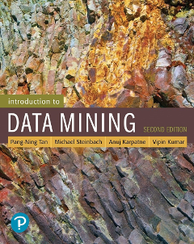
References
Regression. Chapter 5. Introduction to Data Mining.

